Slide 1

Group Project Proposal
s15379 – A. H. Sandali
s15397 – W. Nipuni
s15408 – N. Danula
s15515 – D. Sandaru
s15527 – S. Gokulan
s15540 – J. Thulari
Group 04

Slide 2

Contents
Survey Topic
Objective
Target Population
Sampling Technique
Sampling Frame
Mode of Data Collection
Procedure & Time Allocations
Key points of the Survey

Slide 3

Survey Topic
Survey to analyze the impact of online learning on the physical and mental health of First-year undergraduates at the Faculty of Science, the University of Colombo in the year 2021.

Slide 4

Objective
To examine how the lifestyle of every student has changed with online learning.

Slide 5

Target Population
First-year undergraduates at Faculty of Science, the University of Colombo in the year 2021.

Slide 6

Sampling technique
Simple random sampling.

Slide 7
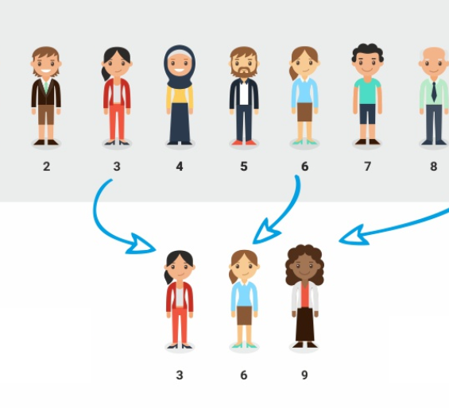
Sampling Frame
University E-mail addresses of first-year undergraduate students at the Faculty of Science.

Slide 8
Mode of Data Collection
E - mail survey
Budget of the survey is need not to be prepared since it is negligible.

Slide 9
Procedure & Time Allocations
2. Conduct the pilot survey and solve the problems regarding to it: 1 Week
3. Collect data : 2 Weeks
4. Present the survey analysis plan and analyze the survey data: 2 Weeks
5. Perform interim presentations
6. Eventually, perform the final presentation.
1. Design the questionnaire: 1 Week

Slide 10

Key points of the Survey
Send the questionnaire to the students through e-mail.
Survey feedback will be collected by google forms and organized with spreadsheet software.
The final report will be presented with the descriptive data analysis which will help us to get an idea about the impact of online learning on the physical and mental health of students.

Slide 11


